Slide 1
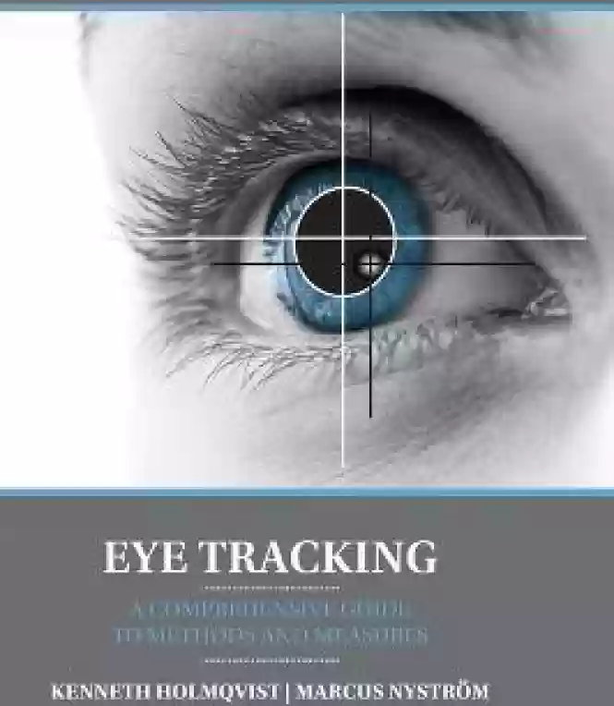
OPERATING COMPUTER CURSOR USING EYE AND FACE MOVEMENTS
Faculty Guide: Mrs. Sradhanjali Pattanaik,
Assistant Professor, CSE
BATCH : C06
Team Members:
P.Pravallika (20NM1A05D9)
S.Devi Vinuthna (20NM1A05H1)
R.Harshini (20NM1A05F3)
P.Charvi Dedeepya (20NM1A05D8)

Slide 2
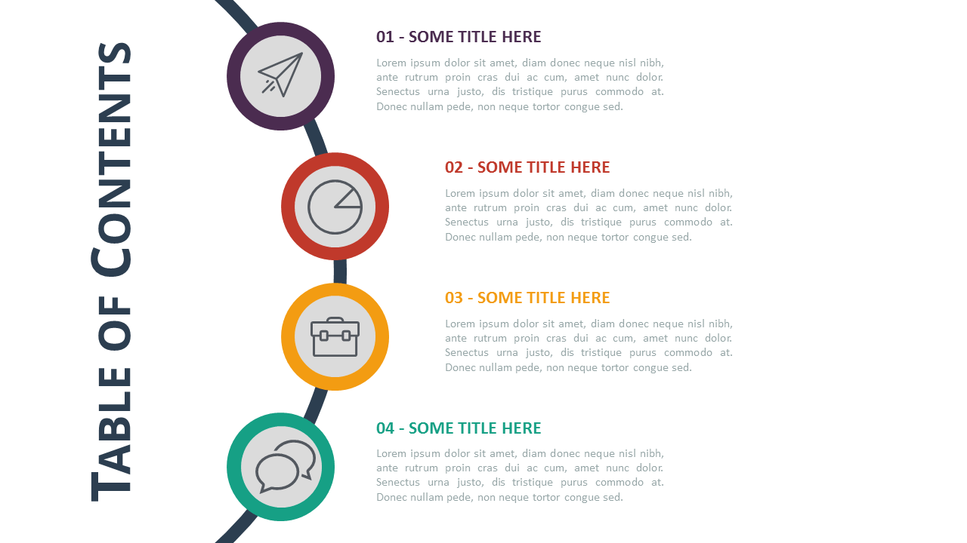
CONTENTS
ABSTRACT
INTRODUCTION
LITERATURE SURVEY
EXISTING SYSTEM
PROBLEMS WITH EXISTING SYSTEM
PROPOSED SYSTEM
SYSTEM REQUIREMENTS
PROPOSED SYSTEM ARCHITECTURE
FLOWCHART
MODULES IN PROPOSED SYSTEM
OUTPUT SCREENS
FUTURE SCOPE
CONCLUSION
REFERNCES

Slide 3

ABSTRACT
The advent of modern human computer interfaces has seen a considerable progress in Hands-free Human Computer Interaction (HCI) solutions. This project focuses on developing a methodology to facilitate computer cursor control for people with physical disabilities such as Quadriplegics and amputees. The proposed methodology takes real-time video input from the user using OpenCV and performs face recognition. The 68-point landmark algorithm is used to locate the various facial features which can be used for cursor control. Opening/closing the mouth based on Mouth Aspect Ratio (MAR) indicates activation/deactivation of the cursor control. The nose tip is used for controlling and moving the cursor in all 4 directions by moving the head left, right, up and down. Eye Aspect Ratio (EAR) is used to detect eyes and eye flickering. Left and right eye blinks indicate left and right clicks respectively. Squinted eyes indicate scrolling of pages, which is beneficial while working with PDFs and other such documents. The proposed system requires very basic requirements like webcam and a few Python libraries such as OpenCV, Numpy, imutils, dlib and PyAutoGUI. Thus, it would help the physically disabled users to efficiently use the computer, thus eliminating the need of a physical mouse interaction.
Keywords:- Eye Tracking, Virtual Mouse, web-cam based interaction, Human-computer interaction, OpenCV, 68point landmark algorithm, MAR, EAR.

Slide 4
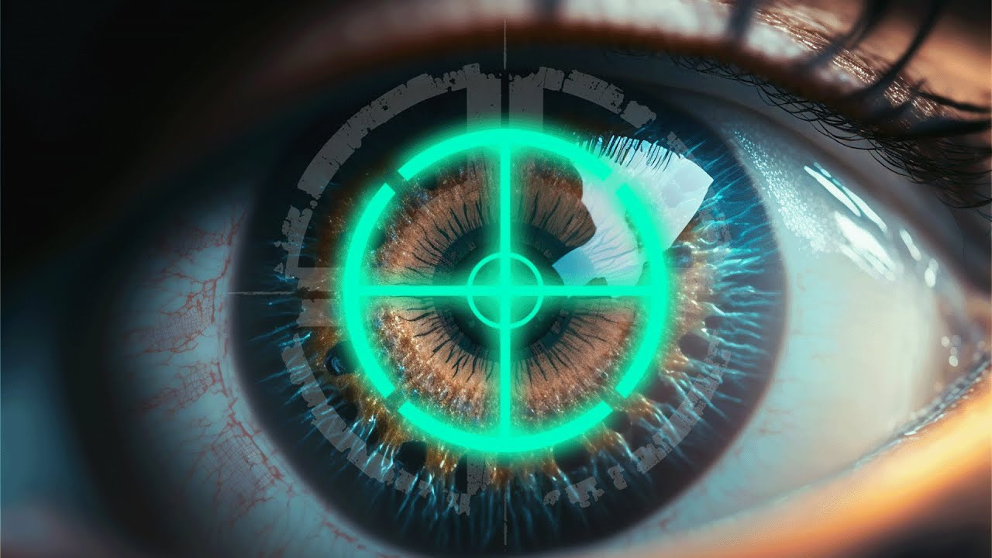
INTRODUCTION
The main aim of this project is to bridge the gap between a disabled user and the computer system, by providing a hands-free computer cursor control system, and to provide operational independence
To build an innovative solution for individuals facing physical challenges in using a traditional mouse by introducing eye gaze and face movements control for the mouse cursor
It requires very basic requirements like webcam and a few Python libraries such as OpenCV, Numpy, imutils, dlib and PyAutoGUI

Slide 5
LITERATURE SURVEY
SNO | YEAR | NAME OF THE AUTHOR | PAPER TITTLE | DESCRIPTION
1 | 2019 | V. Khare S. G. Krishna S. K. Sanisetty | Cursor Control Using Eye Ball Movement | An eyeball based cursor system with the pupil as the main point. The cursor moves according to the eyeball movements. The Blinks are translated into clicks based on EAR value
2 | 2019 | Sukrit Mehta Sharad Dadhich Sahil Gumber Arpita Bhatt | Real-Time Driver Drowsiness Detection System Using Eye Aspect Ratio and Eye Closure Ratio | A Real time driver’s drowsiness detection system is developed which is capable of detecting the facial landmarks, computes Eye Aspect Ratio (EAR) and Eye Closure Ratio (ECR) to detect driver’s drowsiness based on the adaptive thresholding.
3 | 2012 | Vasanthan M Murugappan M R. Nagarajan Bukhari Ilias J. Letchumikanth | Facial expression based computer cursor control system for assisting the physically disabled person | A set of five facial expressions are used for controlling cursor movement in left, right, up and down direction and click, respectively. Four small luminous stickers are fixed on subject's cheeks, forehead, mouth.

Slide 6
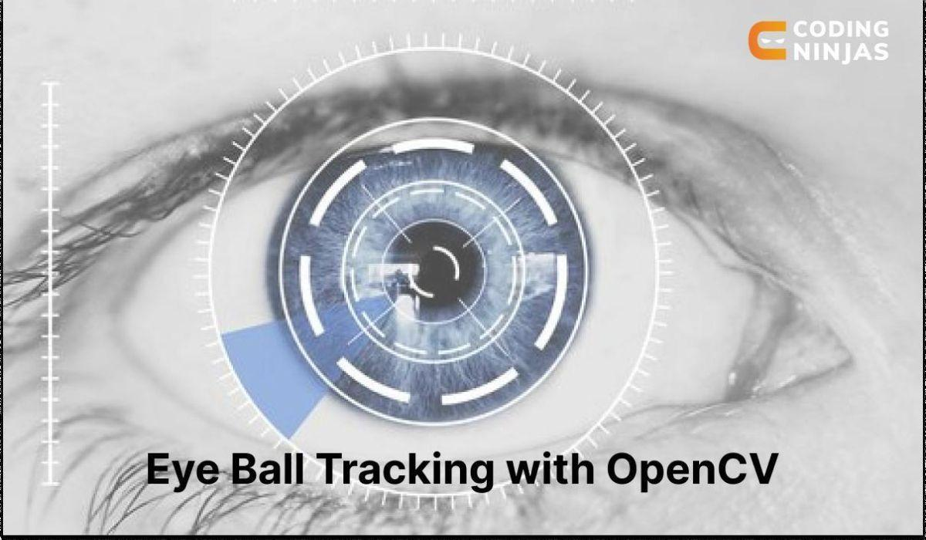
EXISTING SYSTEM
Eyeball Movement based Cursor:
The eyeball movement based cursor uses an Internet protocol camera to take the image of an eye frame for cursor movement
Open source Computer Vision python module is used to take snaps of the eye and it is compared against the EAR (Eye Aspect Ratio) threshold.
The cursor will move on the screen depending on how the eye ball is moving, i.e. by mimicking the movement of eye . The user has to move his eyes and focus on where he wants the cursor to move, and it will move accordingly. Clicks are performed by eye winking

Slide 7

PROBLEMS WITH EXISTING SYSTEM
Enabling and disabling of cursor-
Enabling cursor after some idle time is not existing only through eye movements
Turning left and right-
Turing our cursor left and right in a specific boundary becomes difficult
Calibration Sensitivity:
Calibration is crucial for accurate tracking. Systems may struggle if calibration isn't precise, leading to misinterpretation of eye or face movements.
Environmental Factors:
Changes in lighting conditions or glare on the screen can impact the performance of these systems. Ensuring a consistent and well-lit environment is important.

Slide 8
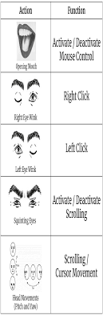
PROPOSED SYSTEM
The proposed system takes Real-time video input using OpenCV
Face detection is done using dlib’s HOG based inbuilt face detector.
The facial landmarks estimator was created by using dlib's pretrained 68 point facial landmark detector.
The landmarks are used to detect certain actions, like using the EAR (eye-aspect-ratio) to detect a blink or a wink, using the MAR (mouth-aspect-ratio) to detect a yawn (activating/deactivating control).
Opening your mouth to activate/deactivate cursor control
Squinting your eyes to activate scroll mode
Winking for left and right clicks
Moving your head around (pitch and yaw) to move the cursor

Slide 9
ADVANTAGES OF PROPOSED SYSTEM
Hands-free cursor for the physically disabled
No external sensors or wearable hardware required
Can be implemented on laptops/ desktop computers easily.
User can perform actions like left click, right click, move the cursor left, right, up, down and scroll the pages.

Slide 10


REQUIREMENTS OF HARDWARE AND SOFTWARE
HARDWARE REQUIREMENTS
RAM: 4 GB or 8 GB
Processor: Intel i3 and above
Hard Disk: 500GB: Minimum
SOFTWARE REQUIREMENTS
Operating System: Windows
Language: Python 3.12.1
IDE: Visual Studio Code
Libraries: OpenCV, Numpy, imutils, dlib, PyAutoGUI

Slide 11
PROPOSED SYSTEM ARCHITECTURE
OPERATING COMPUTER CURSOR USING EYE AND FACE MOVEMENTS
Face Detection
Real time Webcam
Input using OpenCV
Image Pre-processing resize and convert to greyscale
Face detection
(dlib HOG face detector)
Comparison of Threshold values
Left Eye Blink: Left Click
Facial Landmark estimation
Right Eye Blink: Right Click
Extract landmarks for the left and right eye, nose and mouth
Squinted Eyes: Scrolling
Pitch and Yaw
Calculate EAR and MAR
Perform mouse action on screen

Slide 12
FLOWCHART
Real time video input
Face detection
No
Face
detection
Yes
Landmark detection
Calculate aspect ratio
No
Threshold value
matched
Yes
Perform mouse action

Slide 13
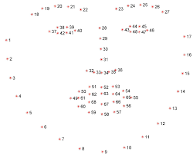
MODULES IN PROPOSED SYSTEM
1) REAL TIME VIDEO INPUT: OpenCV VideoCapture() function is used.
2) FACE DETECTION AND IMAGE PROCESSING:
Image pre-processing: Resizing using imutils’s resize() function and
convert to greyscale using OpenCV cvtColor().
Dlib’s inbuilt Histogram of Oriented Gradients (HOG) algorithm based face detector is used..
3) FACIAL LANDMARK ESTIMATION:
Dlib library’s 68 point facial landmark algorithm based predictor is used.
Extract the left and right eye coordinates, mouth coordinates and the nose pointer ,then draw contours around eyes and mouth using OpenCV’s drawContours().
Calculate the EAR and MAR values.

Slide 14
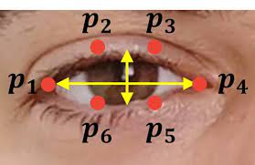
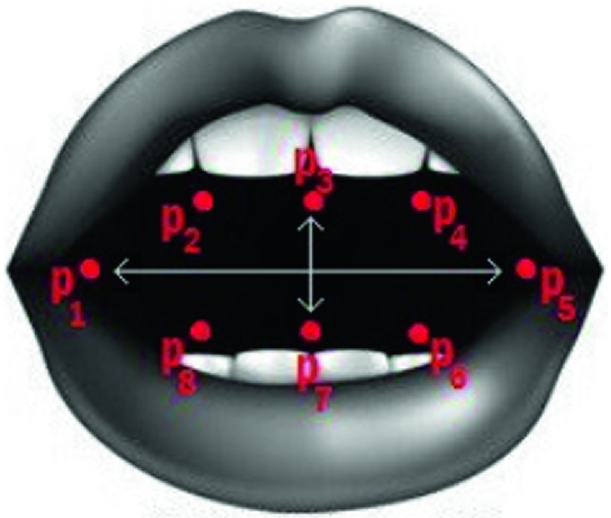
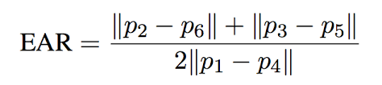
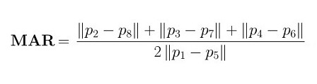
EYE ASPECT RATIO
(EAR)
MOUTH ASPECT RATIO (MAR)

Slide 15
4) COMPARISON OF THRESHOLD VALUES:
If the mouth aspect ratio is greater than the Mouth threshold value the input is accepted by the system
If left_EAR < right_EAR, then left click is performed. Similarly, if left_EAR > right_EAR, then right click is performed.
If the aspect ratio of both the left and right eye together is less than the threshold value, the scroll mode is implemented .
Pitch and Yaw movements of the head will result In moving the nose pointer, and eventually the cursor in all 4 directions
5) PERFORM MOUSE ACTION:
Translate the eye and face movements into corresponding mouse moments using pyautogui.

Slide 16
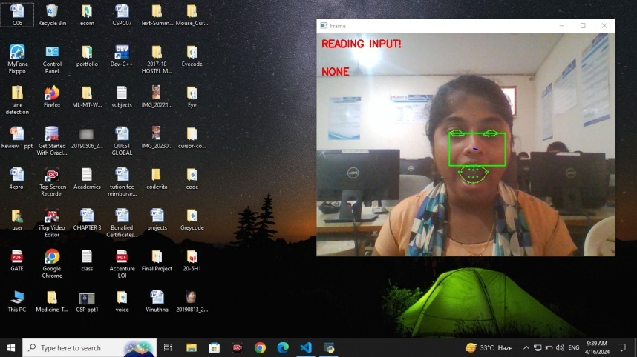
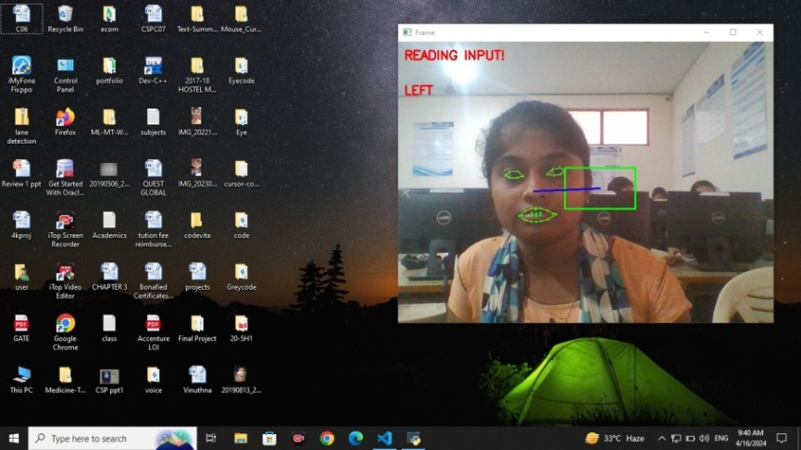
OUTPUT SCREENS
Fig 3: Reading Input
Fig 3 depicts activating the cursor. Open the mouth widely ,then reading input is displayed in the frame. If mouth is opened for the second time, the cursor will be deactivated.
Fig 4: Moving cursor to the left
Fig 4 depicts moving the cursor towards left. If head is slightly moved left, the distance between nose pointer and anchor pointer increases and the cursor starts moving left.

Slide 17
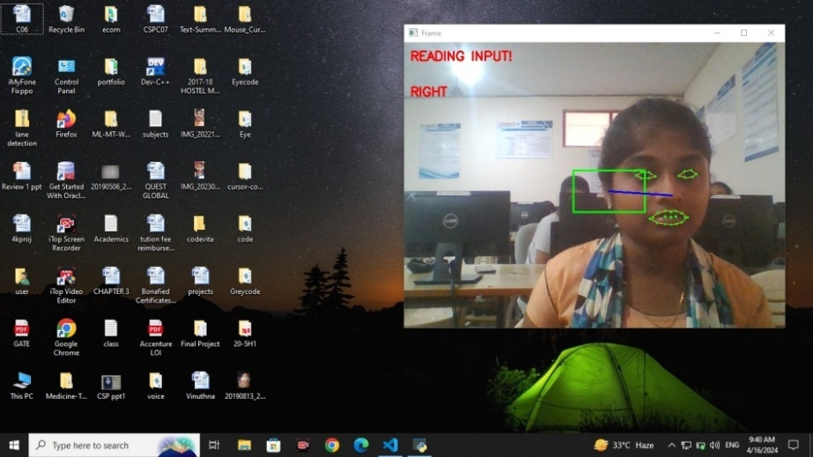
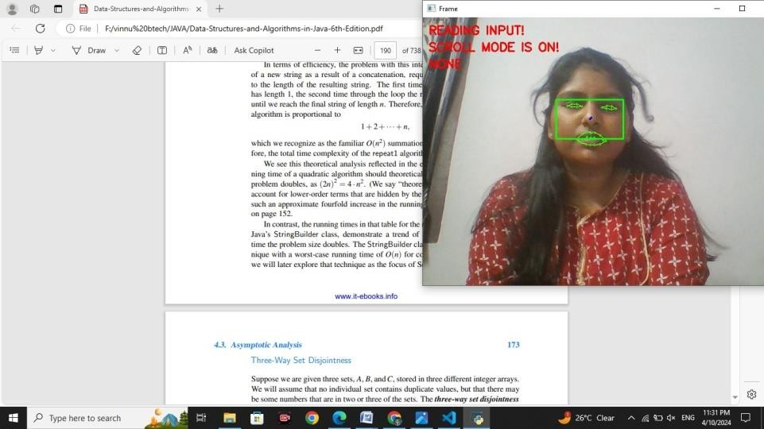
OUTPUT SCREENS
Fig 5: Moving cursor to the right
Fig 5 depicts moving the cursor towards right. If head is slightly moved right, the distance between nose pointer and anchor pointer increases and the cursor starts moving right.
Fig 6: Enabling scrolling effect
Fig 6 depicts the enabling of scrolling effect. If both the eyes are squinted, it enables scrolling mode allowing us to scroll through documents or web pages seamlessly.

Slide 18
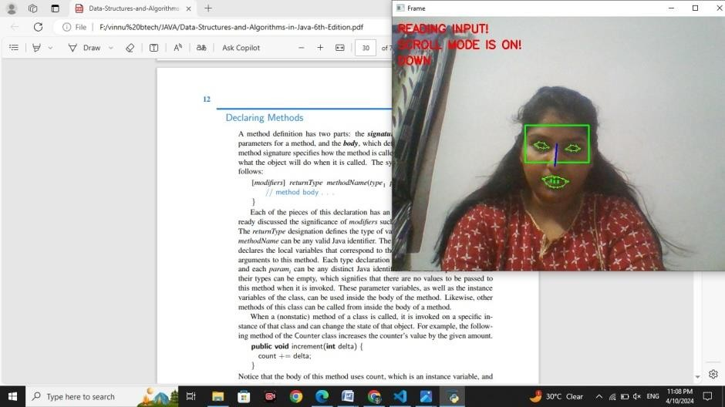
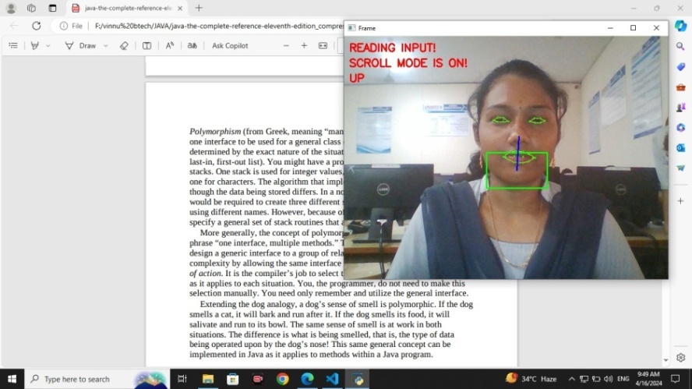
OUTPUT SCREENS
Fig 7: Scrolling Down
Fig 7 depicts scroll action. To start scrolling, start with squinting your eyes (to look with the eyes partly closed eyes) and scroll mode is turned on. Now scroll down by moving your head downwards.
Fig 8: Scrolling up
Fig 8 depicts scroll up action. While scroll mode is on, move your head upwards to scroll up and to deactivate scrolling squint your eyes again.

Slide 19
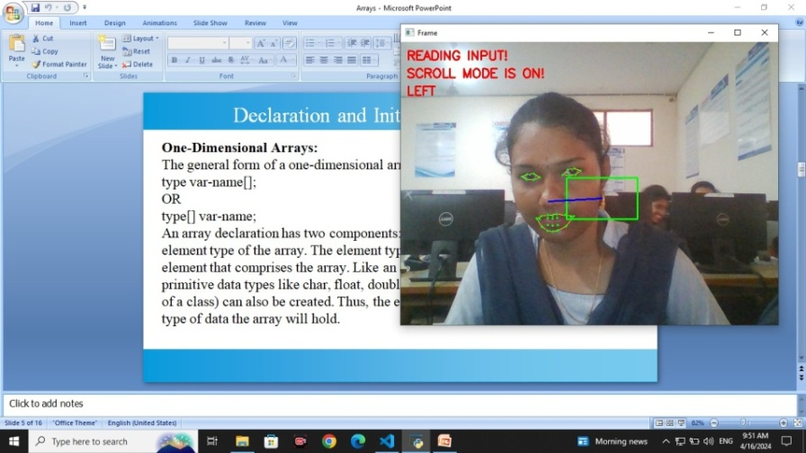
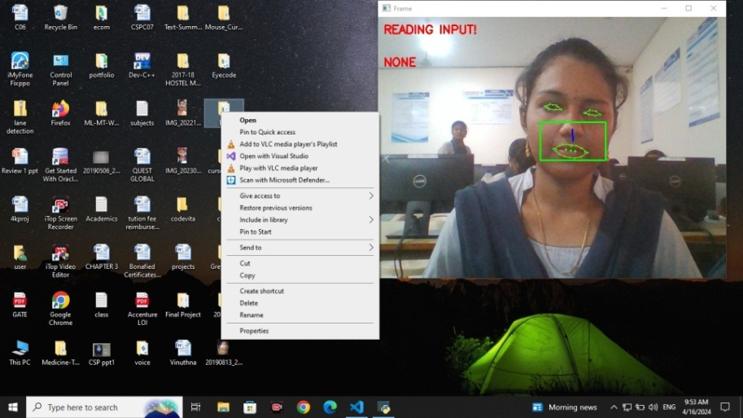
OUTPUT SCREENS
Fig 9: Scrolling left
Fig 9 depicts scrolling left. When scroll mode is on, move your head towards left to scroll the document left. We can similarly move head towards right for scrolling right.
Fig 10: Right Click
To perform click action slightly tilt your head left and wink right eye for right click and left eye for left click as shown in Fig 10

Slide 20
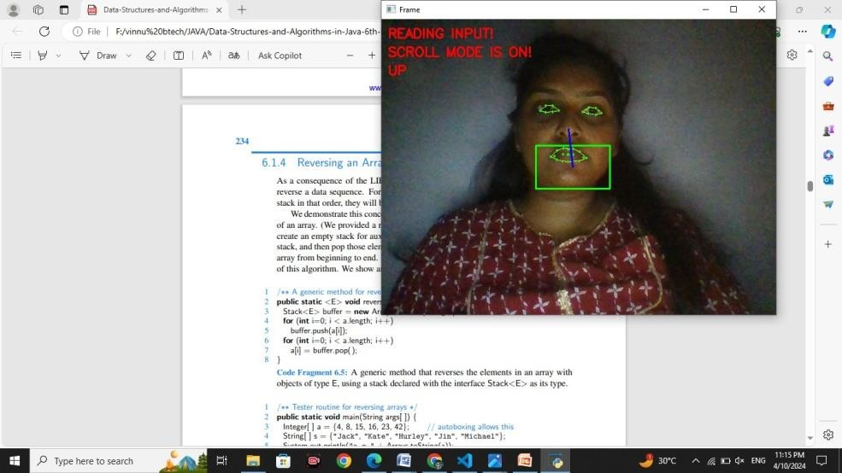
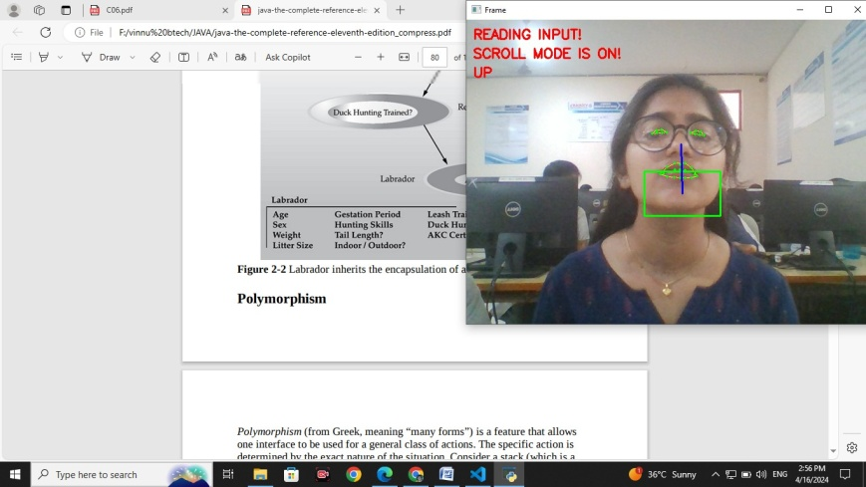
OUTPUT SCREENS
Fig 11: Operating cursor control system in dim light
Fig 11 depicts operating the proposed system in a dim light condition. The system is able to successfully operate and perform the required actions.
Fig 12: Operating cursor control system by a user wearing glasses
Fig 12 demonstrates operating the proposed system when the user is wearing glasses. The system is able to precisely locate the landmarks and perform the required action.

Slide 21
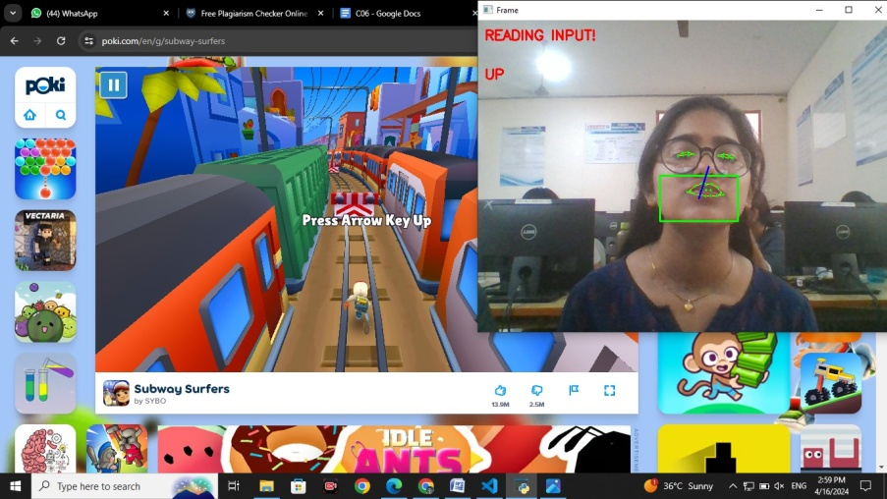
OUTPUT SCREENS
Fig 13: Playing a simple online game with the help of eye cursor system.
Fig 13 depicts operating the proposed system in a simple online video game. The system was able to perform all the required actions successfully.

Slide 22
FUTURE SCOPE
Integration with Assistive Technologies:
Integrate the eye and face movement-based cursor control system with existing assistive technologies and accessibility devices, such as screen readers, speech recognition software, and alternative input devices
Collaborate with assistive technology vendors and organizations to ensure seamless interoperability and compatibility with a wide range of assistive devices and software solutions
Multi-Modal Interaction:
Explore multi-modal interaction techniques that combine eye and face movements with other input modalities, such as voice commands, gestures, and touch inputs. Enable users to interact with the computer system using a combination of input modalities for enhanced flexibility and efficiency

Slide 23
FUTURE SCOPE
Cross-Platform Compatibility:
Ensure cross-platform compatibility by developing versions of the software for different operating systems and computing platforms, including desktop computers, laptops, tablets, and mobile devices
Optimize the software for touch-enabled devices and explore integration with augmented reality (AR) and virtual reality (VR) platforms for immersive and interactive experiences

Slide 24
CONCLUSION
In conclusion, the development of a system for operating a computer cursor using eye and face movements represents a significant advancement in human-computer interaction technology. By harnessing natural eye and facial gestures, this system offers a novel and intuitive method for users to interact with their computers, potentially enhancing accessibility, productivity, and user experience. Throughout the project, careful consideration must be given to factors such as accuracy, responsiveness, user comfort, and privacy to ensure the system's effectiveness and acceptance. Integration testing plays a crucial role in validating the interactions between various components, verifying the reliability and functionality of the system, and identifying any issues that need to be addressed. The project outcome is a sophisticated software application or system that seamlessly integrates eye and face tracking algorithms with cursor control mechanisms, providing users with a seamless and intuitive means of navigating their computer interfaces.

Slide 25
THANK YOU!

